Slide 1

Welcome to COMP2001 Information Management and Retrieval
Martin Read
Notes:
Welcome to the session on introducing API’s.

Slide 2
Session
API’s
Web Services
How do they fit? - part 2 of your coursework
Building code on top of your data layer

Slide 3
APIs
What is an API? Explore what an API is, the different viewpoints
Why have an API? Look at why API’s are created, strategy behind them & context
How to use an API? Consider the different ways of using APIs
Working definition What this course will consider as the definition for API
Notes:
In this introduction we shall explore what is an API as there is no definitive explanation for the term and it can mean many things to many people.
From there we look at the reasons behind having an API, why should having one be desirable, or why should using one be desirable. Here we examine the context – what is it about modern software development that makes this concept of the API important.
There are different ways of using APIs and here we touch on those – as just an outline, a signpost.
Finally we complete the session with the definition of an API that this course will be working on.

Slide 4

What is an API?
Request
Response
“Application Programming Interface”
Software to Software communication
A method to deliver data or service
A developers contract
API
Notes:
What is an API?
The term is an acronym for Application Programming Interface.
We are looking at something that has no pretty bits for human beings to marvel over, it is a way of one piece of software communicating with another piece of software, it is machine to machine communication, or even on the same machine.
An API is a hook for accessing data or a service and is part of our very connected world. Before the dominance of the web and the Internet, an API would allow you access into other software – for example the Win32API allowed you access to functions and/or data structures provided by the operating system. Now we are in the web world and these API’s take on a different life.
An API provides a contract to a developer that data or web services will be delivered, and as such a developer will rely on that API.
At a base level all API’s will do the same thing. They receive a request, process it in some way and return a response.

Slide 5
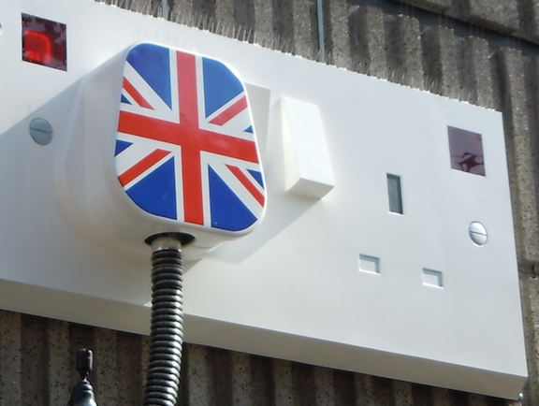
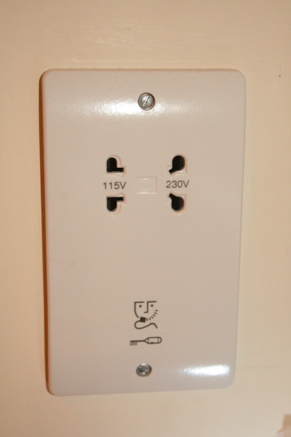
Notes:
Generally you know what to expect with a plug. You know what to plug into it. You know looking at it that you don’t put the same type of plug into the left hand socket as you do in the right hand socket.
This is a standard interface. Any compatible plug can access the power – and the device that has the plug knows what to do with the power. Those who make devices can do so safe in the knowledge of what they are getting – they are getting something conforming to the standard. They don’t have to worry about how they will get to the power, they just know it will get delivered.
The socket is a layer of abstraction. The device maker does not need to know about the colour of the wires, or whether the electricity is from a renewable source or not, where the power has come from, The abstractions go both ways. The socket maker does not need to know about the device being plugged into it, the electricity provider does not need to know about the devices consuming the electricity.
And so it is the same with data or messages. That is what an API delivers, data that can be consumed by the application that calls it. So the app itself does not need to worry about how to store the data, how to ensure it’s integrity – it outsources those requirements. As an app developer you can pull in functionality from these API’s without having to create it yourself.
CC2 (https://creativecommons.org/licenses/by/2.0/) British Power image courtesy of https://www.flickr.com/photos/kevandotorg/
Shaver socket - By Wiz9999 - Own work, CC0, https://commons.wikimedia.org/w/index.php?curid=69707354

Slide 6
Why?
Interconnectivity Many now expect instant connectivity via devices they carry. Have become used to looking up information on the move
Data Sharing between devices is now expected. Consumers expect to have same seamless interaction irrespective of device. However, data needs to be in one place & needs to be shared consistently and robustly
Developers Infrastructure Irrespective of language application created in - access other features & data sets that would be beyond your reach to create yourself
Notes:
We live in a world of interconnectivity. Consider the devices you use today. Did you look up your train time? Perhaps you looked up the traffic to see about how to get to where you wanted to go. May be you were shopping online, comparing prices, or looking for a holiday and comparing flights. Each of those companies hold their data in their databases – you do not have direct access to their databases, but via an app, via an aggregator you may be granted special privileged access to their data – because they have allowed it.
Many have become used to that connectivity. They are using the many devices they have and they want to not to have to re-enter their data, or they want the interaction to be seamless. However, for that to work effectively the data must be held in one place, accessible by the many different clients and to have no dependencies between the different pieces of software or platforms. Imagine if you had to have one place to store data that worked android applications and one place to store data for apple devices. There has to be a uniformity in sharing data, the applications need to be able to deal with that data without too much overhead.
Finally this links into the developers infrastructure. This is about having developers as partners in business without having to hire them, but where software, applications are created that bring business via the API in such a way where everybody benefits.

Slide 7
Usage
Mobile ownership Smartphone ownership increasing – globally. Over 50% of website traffic now delivered to a mobile device
Internet 40% of the world had internet connection in 2018
Websites Increasingly features in websites are provided by third parties – not the web developer themselves. Google maps API is a good example.
UK Households with mobile phones*
Internet users 2018
Website traffic via mobile
95%
52.2%
over 3 billion
Notes:
So the reason why this is pertinent to today is very much around our ownership of these devices. Looking at the figures the majority of UK households – 95% - are spending money on mobile phones. It is rare for somebody NOT to have a mobile now. When we look globally we see that the gap between the established economies and the emerging economies is shrinking.
Add to the mobile device ownership statistics, we also see how much is now delivered via the internet. 52.2% of website traffic is now delivered to a mobile device. There are over 3 billion internet users now. 40% of the world has an internet connection.
Think about the websites you have made use of. What interactivity did they have with them? Increasingly the features you see in the websites are provided by third parties – not the web developers themselves. Look at how a number of websites will embed a map – where does that map come from? Google. Google Maps API is a good example.
Pew Internet report - http://www.pewglobal.org/2016/02/22/smartphone-ownership-and-internet-usage-continues-to-climb-in-emerging-economies/. Smartphone ownership and internet usage continues to climb in emerging economies. 2016.
* Household Spending figures from ONS for financial year ending 2015 to financial year ending 2017. https://www.ons.gov.uk/peoplepopulationandcommunity/personalandhouseholdfinances/expenditure/datasets/percentageofhouseholdswithdurablegoodsbycountriesandregionsuktablea48
Website traffic Figures from statista https://www.statista.com/statistics/241462/global-mobile-phone-website-traffic-share/
Internet users Figures from http://www.internetlivestats.com/internet-users/

Slide 8
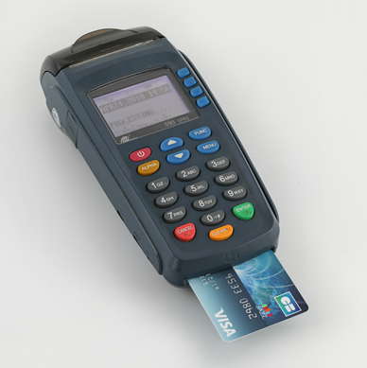
Benefits : Consuming API’s
Developers create software quickly using established APIs
Established APIs usually often-repeated, complex pieces of functionality – developers use them with a few lines of code
credit card payments
Notes:
So lets look at the benefits of APIs. First lets look at the benefits around using them and from this perspective we consider the developers community as they are the ones making use of these APIs.
Developers can quickly make use of third party API’s to create apps that are quite feature rich. App developers can use API’s offered by the system they are working on – for example using the APIs provided by the device provider they can access the GPS data, the location of the phone.
The well established API’s wrap up and abstract often-repeated, complex pieces of functionality and then make that available to the developer with just a few lines of code. This makes the developer much more productive than having to write everything from scratch. Credit cards are a good example. There are a number of issues around dealing with the processing of those payments – this chart shows you the interactions that have to take place. Then there are the security issues – storage of personal details is not something to be undertaken lightly. There are plenty of rules around how personal data must be handled – GDPR for example in the UK. What about trust issues – would you buy from somewhere that might take your credit card details and then allow them to be used in a fraudulent fashion?
So it is much easier in that regard to use a few lines from a third party API that deals specifically with processing payments – Paypal or Stripe.
By Basile Morin - Own work, CC BY-SA 4.0, https://commons.wikimedia.org/w/index.php?curid=68543817
By Nitishwiki33 [CC BY-SA 4.0 (https://creativecommons.org/licenses/by-sa/4.0)], from Wikimedia Commons

Slide 9

API Economy
Access to digital assets/services in controlled fashion that directly improves productivity
Smartphone - accessing devices
Web browser APIs provide access to
Camera
Hosts File structure
Audio
Active apps and websites use Google Maps API
Growth for Google Maps
2 million
300%
Instagram – built on the Facebook API
Notes:
In recent years we see the “API Economy” emerge. The exposure of the digital services and/or assets of an organization. This allows a controlled access that has a positive effect on an organizations profit margin. As the Internet of Things becomes the norm, accessing devices via smartphones becomes desirable, so too does the provision of an API to manipulate the “things”.
And it is not just “things” – there is the every day use of the web too. Modern web browsers now provide access via APIs. You can access the camera, the host file structure and audio for example.
API’s have been referred to as the “engine of innovation” (Programmable web). Think about Uber – the use of Google maps helped drive the application. Google Maps API spawned more innovation than just Uber, according to Apigee in their 2017 report on the state of API’s over 2 million active apps and websites use the Google Maps API every week, which contributed to Google Maps growth of 300% over the last two years. Then there is Instagram – built on the Facebook API allowing the users to broadcast latest photos on Facebook.
APIGee - https://apigee.com/api-management/#/resources
By Joka2000 Camera https://www.flickr.com/photos/joka2000/ Creative Commons 2:0

Slide 10
Benefits : Providing APIs
Internally – information wrapped up and delivered easier
Externally – open up new markets, attract new innovation by enabling core business services to be “mashed-up” by people from outside
Twitter API
Notes:
The other side of the API coin is that people need to provide them.
https://apigee.com/about/blog/technology/why-and-how-apis-open-api-model

Slide 11
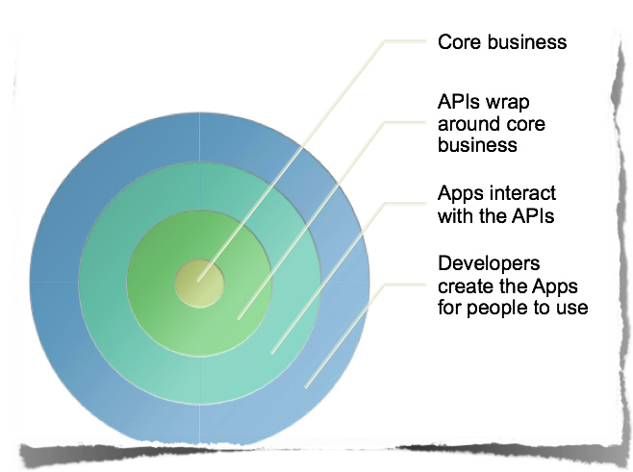
Apps

Slide 12

Working Definition
May be over a network (the internet)
API's follow a specification - including technical, legal constraints
API is a way of two software applications talking to each other using a common language that they both understand
Notes:
And so to our working definition that we shall use throughout this course.
An API is a mechanism that provides a way for two software applications to talk to each other using a common language that they both understand.
This could be done over a network – usually the internet. However, they could be on the same device or machine – but in our case they still need to be delivered over TCP/IP – internet protocols.
API’s have to follow a specification. That specification means the API provider describes exactly what the functionality is that the API is offering, they describe any technical constraints within the API, such as rate limits that might control how many times an application can make a request. The API provider might also outline in the specification any legal or business constraints for using the API – branding limitations, conditions of use and others. Developers have to agree to use the API as described and they agree to the rules set out by the API provider.

Slide 13
API Development

Slide 14
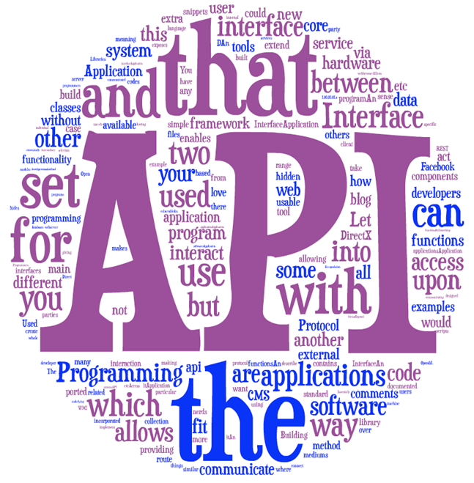
API
Machine to machine application providing
Data
Service
Additional functionality
Call a URI
Send a message
Receive something back

Slide 15
RESTful APIs
URI’s and URL’s map to resources
Resources are “things” (nouns)
Uses HTTP Request / Response mechanism
Provides various different data formats
JSON
XML
Original principles outlined in Fielding’s thesis Representational State Transfer (REST)
https://www.ics.uci.edu/~fielding/pubs/dissertation/rest_arch_style.htm

Slide 16
Consuming an API
Call an “Endpoint”
A URL represents an Endpoint
A server application will be implementing the workings behind the interface
ASP.NET MVC is an implementation of this approach
Notes:
You need to write the code that makes it happen - behind that end point.
ASP.NET - templates deal with the routing for you - where it needs to go.
When creating your microservice - need to make sure that you're picking up where the controllers are going to operate.

Slide 17
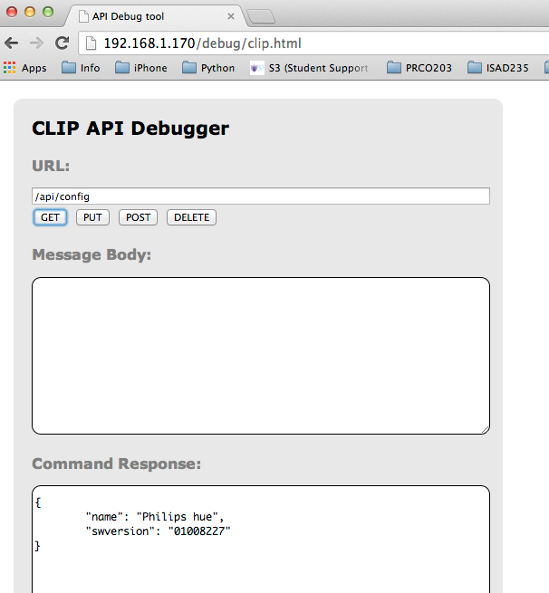







1
Inbound routing : URL is matched in table against routine rules and mapped to the appropriate controller and action
Routing Table
2
Controller
View
4
6
5
3
Model
Outbound routing : URL is generated from routing rules and used as links on pages
Notes:
incoming URI (whatever the IP address is that you polled or the domain or path, etc)
The application routing table knows where to send bits - goes to the controller.
If it's a GET - knows it's got to do one method, DELETE another & so on.
Interacts with the model - your data context, data layer - & then data goes out

Slide 18
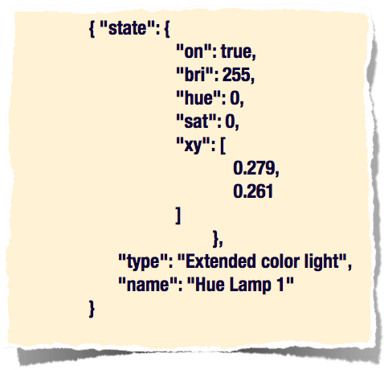
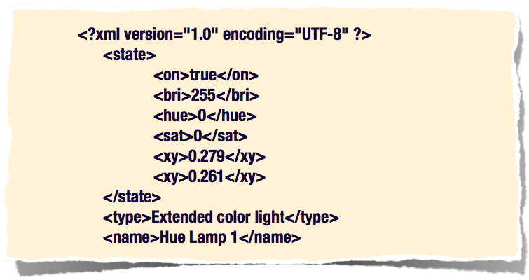
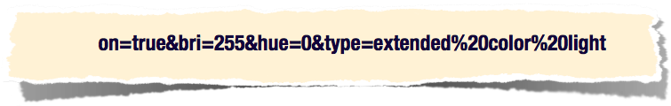
Data Format
JSON
Smaller than XML
Faster to process in a browser
XML
URL encoded data

Slide 19
Creating an API
Useful for adding a wrapper around data
Expose functionality as a web service
A web service providing data from one machine to another
REMEMBER: a resource represented by a unique URI
Based on client/server architecture
Clients initiate a request to the server
Server processes request and returns an appropriate resource
Create in one place
Use by many clients

Slide 20
Web Services
Self-contained
Available over a network
Software modules that perform a specific task
Deployed easily because they use common industry standards
E.g.: existing network infrastructure
HTTP mechanism along with JSON/XML

Slide 21
Web Services
Any service available over the internet
Provides a specific piece of functionality through an internet connection
Uses a standardised messaging system
Not tied to an OS or programming language
Needs to be self-describing
Discoverable

Slide 22
Web services
Delivered in a number of different ways
Remote procedures call (RPC)
REST
Essentially an application that allows
methods to be called by applications on other machines
via some form of common data format
Notes:
There's different sets of ways of accessing Web services - the traditional way was RPC, but we are using REST

Slide 23
Activity
Groups of 3 or 4 people
Scenario: An airline would like to add car rental services to their online ticket sales system.
The reservation system they have operates from a database of flight information.
Ticket system needs to obtain rental data from the car rental agencies.
List what you think the barriers might be to such a system?
10

Slide 24
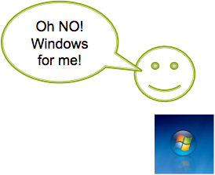
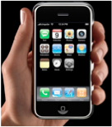
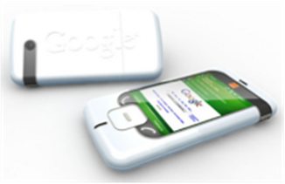
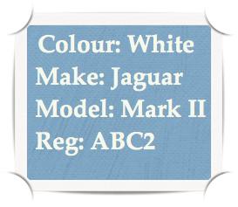
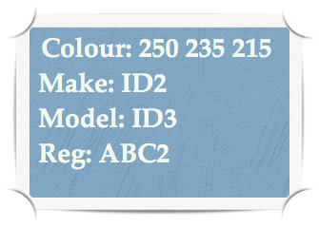

Barriers
Different platforms
Different formats
Notes:
There may be different platforms or different formats.
This is the same data – A White Jag but described possibly differently. Still white – but stored in RGB perhaps that links to another table
RESTful - you are only dealing with HTTP. You are not dealing with any other file transfer protocol.

Slide 25
Solution
Web services created to share data
Uses standards for interactions between the systems
Machine-to-machine communications standardised
XML
JSON
Notes:
Using Web services to create a more holistic application and got some standards. you interact between them

Slide 26
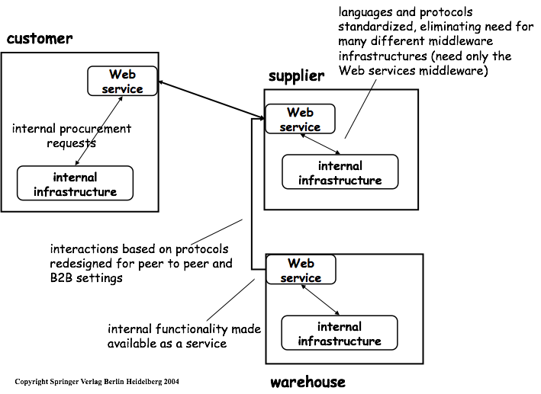
Notes:
A schematic of how that might work for a web service for one place.
We've got our airline that's calling the Web service from the car manufacturer, e.g. a supplier.
Usually there's been a discussion between the two parties.
How do we want to operate? What are the principles?
How will you expose my API and how will you call that?
And they'll be in trade agreements, etc
just gives you an outline

Slide 27
Interfaces
Web services must have an interface
Interface must be published
Interface is the contract that specifies
the available inputs
formatting of the outputs
protocols used for transmission
Protocols are internet standards
Example:
Query car rental web services using XML query
Query is generated based on published interface
Receives XML response from web service
Uses known interface to translate data
Notes:
Web service has to say what the interface is - What data do you give me and what data will I get back
That is the developers contract.
The protocols themselves are the Internet standard ones - not FTP, etc

Slide 28
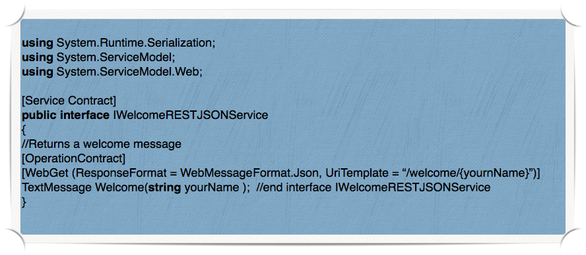
Implementation
Implementation is complex
REST (arguably easier)
.NET
Windows Communication Foundation (WCF) services
Set of technologies for building distributed systems
uses both SOAP & REST
Notes:
Implementation can be quite complex - the reason we are looking predominantly at RESTful APIs is because it is the most simple.
If you Google things. You will find Windows Communications Foundation services & plenty of stuff online - Try and avoid them for the moment. Stick to restful
An example of a contract.

Slide 29
REST
REST uses current network infrastructure
Relies on HTTP Request/Response mechanism
Uses HTTP verbs - GET, POST, PUT, DELETE
Does not need data wrapped in special message format
Representational State Transfer (REST)
often called RESTful
Identified by unique URL - server knows what to do with it
Uses variety of formats for data
JSON, HTML, XML, plain text
Notes:
We're focusing on REST - Because it is using the HTTP request response mechanism

Slide 30

University of Plymouth
Advancing knowledge, transforming lives

